Slide 1
The Subversion of Public Health:
Consumer Perspectives
Nancy E. Loucas
Executive Coordinator, CAPHRA
Notes:
International Human Rights Standards and Conventions make clear that the right to health is the responsibility of the state and the right of every person.
The definition of Harm Reduction is “mitigating risk/harm to reduce the negative social, health, legal and financial activity/behaviour”
It is something that every one of us practices daily, sometimes without even being consciously aware of it.

Slide 2
The Subversion of Public Health: Consumer Perspectives
The preamble to the Constitution of WHO states that the enjoyment of the highest attainable standard of health is one of the fundamental rights of every human being without distinction of race, religion, political belief, economic or social condition.
The WHO Framework Convention on Tobacco Control (FCTC) lays out specific, evidence-based actions that all Parties to the Convention should take to reduce the harm from tobacco, and are mandated to include civil society in the process
Notes:
The preamble to the Constitution of WHO states that the enjoyment of the highest attainable standard of health is one of the fundamental rights of every human being without distinction of race, religion, political belief, economic or social condition.
The WHO Framework Convention on Tobacco Control (FCTC) lays out specific, evidence-based actions that all Parties to the Convention should take to reduce the harm from tobacco, and are mandated to include civil society in the process

Slide 3
The Subversion of Public Health: Consumer Perspectives
What We Know:
Public health is ‘the science and art of promoting health, preventing disease and prolonging life through the organised efforts of society.’
Notes:
Public health is ‘the science and art of promoting health, preventing disease and prolonging life through the organised efforts of society.’
But what happens when those who are either the beneficiaries or victims of Public Health Policies want a seat at the table when policies are developed?
What happens when adults question the "expertise" of those who are mandated to protect their health?
What happens when citizens and policymakers are not given the full information to make informed choices about their health?

Slide 4
The Subversion of Public Health: Consumer Perspectives
Who WE are (Consumers/Advocates)
We are adults who have exercised our right to “enjoyment of the highest attainable standard of health”
What we want is for all adults to be able to make informed decisions so they can switch to safer products if they smoke or use unsafe oral tobacco.
Notes:
Who, What, Why, When and...
We are adults who have exercised our right to “enjoyment of the highest attainable standard of health”
What we want is for all adults to be able to make informed decisions so they can switch to safer products if they smoke or use unsafe oral tobacco.

Slide 5
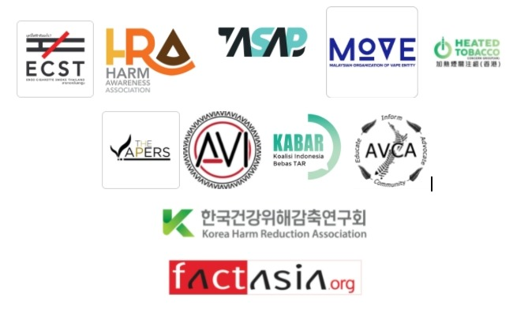
The Subversion of Public Health: Consumer Perspectives
What We Know:
Consumers believe that the global health community has failed miserably in the rejection of Tobacco Harm Reduction (THR).
Many have experienced the damage from the "Tobacco Pandemic" first hand the disease and death from loved ones for whom the "approved" methods of cessation have failed miserably.
Notes:
Consumer Advocates strongly believe that the global tobacco control community has failed miserably in their rejection of Tobacco Harm Reduction (THR).
Many have experienced the damage from the "Tobacco Pandemic" first hand - the disease and death from loved ones for whom the "approved" methods of cessation failed miserably.
You can walk to up to any one of the consumer advocates here today and ask. This is not about money or glory or attention, this is about saving lives, our own and those of the people we care about

Slide 6
The Subversion of Public Health: Consumer Perspectives
WE have Questions that DEMAND Answers
When will Tobacco Harm Reduction be approached with the same respect and reverence as the other forms of Harm Reduction endorsed by WHO?
How is it that the experts that we depend upon to protect our health through evidence-based guidelines and pragmatic policies have got it so wrong?
How is it that Harm Reduction is embraced and celebrated in every other aspect of Public Health, EXCEPT when it comes to Tobacco?
Notes:
We have questions that demand answers.
When will Tobacco Harm Reduction be approached with the same respect and reverence as the other forms of Harm Reduction endorsed by WHO?
How is it that the experts that we depend upon to protect our health through mandated evidence-based guidelines and pragmatic policies have got it so wrong?
How is it that Harm Reduction is embraced and celebrated in every other aspect of Public Health, EXCEPT when it comes to Tobacco?

Slide 7
The Subversion of Public Health: Consumer Perspectives
What We Know:
Most Tobacco Control/ Public researchers and experts entered the field because of their experiences with tobacco harm in their families.
We are fighting the same battle - we want to eradicate the scourge of the “Tobacco Pandemic”
Notes:
Most Tobacco Control/ Public researchers and experts entered the field because of their experiences with tobacco harm in their families.
We are fighting the same battle - we want to eradicate the scourge of the “Tobacco Pandemic”
Tobacco Harm Reduction (THR), challenges orthodoxies in Tobacco Control.

Slide 8
The Subversion of Public Health: Consumer Perspectives
Failure, within WHO, is a recurring theme...
"The global public health community has failed twice in responding to major outbreaks within one decade: the Ebola epidemic in 2014 and the SARS-Cov-2 pandemic in 2020...
The weaknesses in the system were well known beforehand."
"The Epidemic Failure Cycle hypothesis: Towards understanding the global community’s
recent failures in responding to an epidemic" - Richter, Zuercher - https://doi.org/10.1016/j.jiph.2021.09.003
Notes:
Failure, within WHO, is a recurring theme...
"The global public health community has failed twice in responding to major outbreaks within one decade: the Ebola epidemic in 2014 and the SARS-Cov-2 pandemic in 2020...
The weaknesses in the system were well known beforehand."

Slide 9
The Subversion of Public Health: Consumer Perspectives
What We Know:
The disinformation offered by FCTC and its affiliates to signatory countries as “guidance” is dangerous and has the potential to cause harm for people who smoke and use unsafe oral tobacco products.
The WHO FCTC has failed, and continues to fail, the 8 million people who DIE from unsafe tobacco products annually.
Notes:
The disinformation offered by FCTC and its affiliates to signatory countries as “guidance” is dangerous.
The WHO FCTC has failed, and continues to fail, the 8 million adults DIE from unsafe tobacco products annually.
Failure within the WHO FCTC is a recurring theme…that is becoming more apparent with each passing day

Slide 10
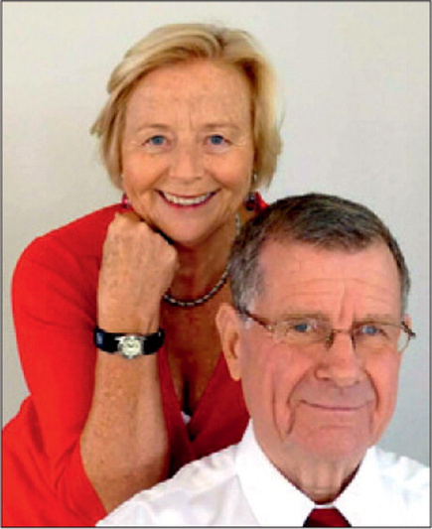
The Subversion of Public Health: Consumer Perspectives
Failure, within WHO FCTC, is a recurring theme...
“Tobacco control is not working for most of the world...
The missing strategy in WHO and FCTC policies is harm reduction...Unfortunately, WHO and the FCTC Conference of Parties reject harm reduction. This opposition is not grounded in 21st century technological advances, and is unduly influenced by vested interests who promote nicotine abstinence.”
Robert Beaglehole & Ruth Bonita, ONZM
Former Directors WHO
"Tobacco control: getting to the finish line."
Beaglehole, Bonita. https://doi.org/10.1016/S0140-6736(22)00835-2
Notes:
When two former WHO employees, who are also world class epidemiologists and public health experts feel compelled to speak out about what is going on at FCTC, we consumers know that we are not alone.
When scientists and medical professionals who were part of the development of the Framework Convention come out and state that Tobacco Control is not working, it is time to admit that Change is necessary.
Change is scary sure, but the death toll from bad policy is even more frightening.
This is the wake up call that the original purpose has been subverted and needs to be assessed and adjusted.

Slide 11
The Subversion of Public Health: Consumer Perspectives
Failure, within WHO FCTC, is a recurring theme...
“We are calling on the WHO leadership to launch a comprehensive rethink. We need to see some sign that WHO is embracing innovation, not squandering the opportunity to make a real difference to the global burden of cancer, heart disease and crippling lung conditions.”
Professor David Nutt DM FRCP
FRCPsych FBPhS FMedSci DLaws
Notes:
One hundred experts have come together to call for an independent review of WHO’s scientific and policy analysis and to challenge its decision-making.
We are calling on the WHO leadership to launch a comprehensive rethink.
We need to see some sign that WHO is embracing innovation, not squandering the opportunity to make a real difference to the global burden of cancer, heart disease and crippling lung conditions.

Slide 12
The Subversion of Public Health: Consumer Perspectives
REALITY CHECK:
Consumers are passionately concerned about massive harm within our families, and in our communities caused by unsafe tobacco products.
Public Health is mandated with the responsibility to protect our health and support and protect the human right to health.
Consumer Advocates & Public Health are on the same side when it comes to the desire to eradicate the harms from tobacco.
Notes:
Consumers are passionately concerned about massive harm within our families, and in our communities caused by unsafe tobacco products.
Public Health is mandated with the responsibility to protect our health and support and protect the human right to health.
Consumer Advocates & Public Health are on the same side when it comes to the desire to eradicate the harms from tobacco.

Slide 13
The Subversion of Public Health: Consumer Perspectives
“The idea is to try to give all the information to help others to judge the value of your contribution; not just the information that leads to judgement in one particular direction or another.”
Richard Feynman, PhD
Nobel Prize Winning Physicist
Notes:
Admit now I am a Feynman Fangirl from way back. Much of what he wrote and said can be applied all aspects of science and life itself.
I’m thinking that this needs to be sent en masse to everyone at FCTC as a reminder. “The idea is to try to give all the information to help others to judge the value of your contribution; not just the information that leads to judgement in one particular direction or another.”

Slide 14
The Subversion of Public Health: Consumer Perspectives
REALITY CHECK:
The FCTC is no longer fit for purpose. It has been subverted to benefit a few, at the expense of the whole.
Back to Basics: acknowledgement of scientific innovation, consumer knowledge and experience - to HELP people, not disenfranchisement or discrimination; INCLUSIVENESS.
Until there is change: Billions of people will continue to be harmed and DIE from a PREVENTABLE cause.
Notes:
The FCTC is no longer fit for purpose. It has been subverted to benefit a few, at the expense of the whole.
Back to basics: acknowledgement of scientific innovation, consumer knowledge and experience, to HELP people, not disenfranchisement or discrimination. INCLUSIVENESS
Until then, billions of people continue to be harmed and die from a preventable cause.”

Slide 15
The Subversion of Public Health: Consumer Perspectives
He aha te mea nui o te ao?
What is the most important thing in the world?
He Tāngata, He Tāngata, He Tāngata
It is the people, it is the people, it is the people
Notes:
This too would be a good reminder for those in Tobacco Control who need reminding what is important.
The He Tangata Principle - Focus on improving people’s lives — individuals, children and young people, families, and communities.
I practiced this in Te Reo at home, and it was not pretty so I will recite it in English:
What is the most important thing in the world? It is the People, it is the people, it is the people.

Slide 16
The Subversion of Public Health: Consumer Perspectives
Notes:
Thank You.

